Slide 1

Generative AI

Slide 2
Module 3
LLMs

Slide 3
What are LLMs?
LLM Architecture
Types of LLM
Applications of LLM
Hands-on

Slide 4
What are LLMs?

Slide 5
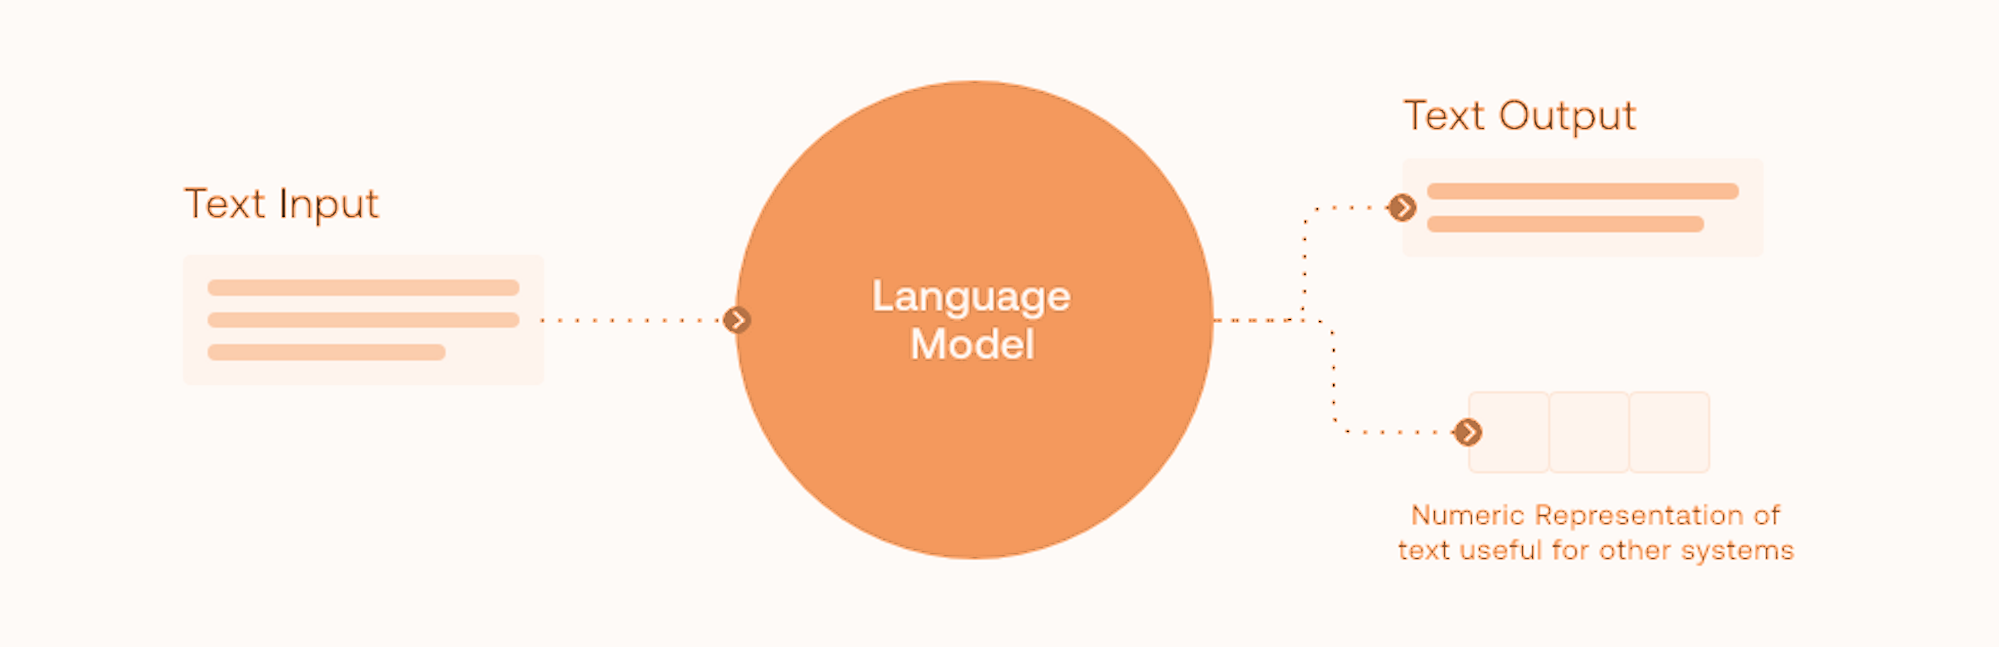
What are LLMs?
Large language models (LLMs) are foundational models trained on vast datasets, enabling them to comprehend and produce natural language and various content types. This extensive training allows them to perform diverse tasks effectively.

Slide 6
LLM Architecture

Slide 7
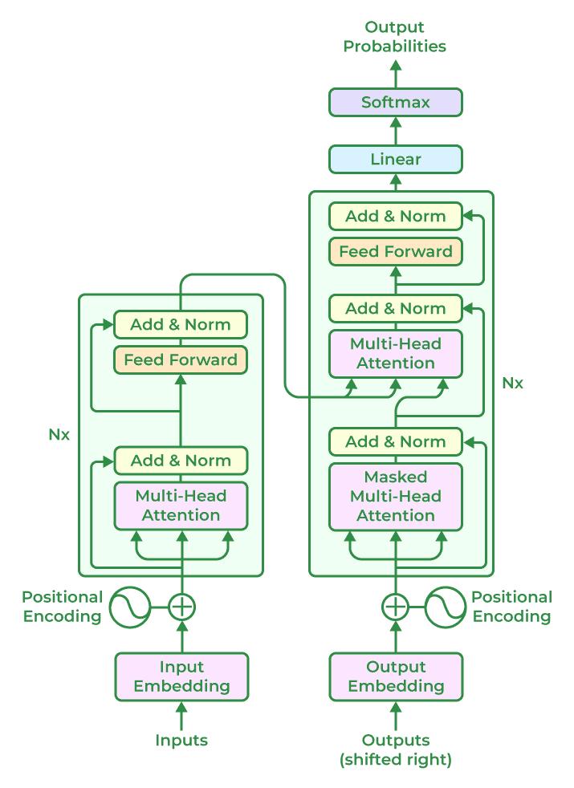
LLM Architecture - Key Components
1
Input Embeddings
2
Transformer Blocks
3
Positional Encoding

Slide 8
LLM Architecture - Key Components
1
Input Embeddings
Input Embeddings
The purpose of the input embeddings is to transform words or tokens into dense vector representations.
For the sentence that we saw in the last module - "The cat sat on the mat," each word is converted into a vector. These vectors capture semantic information about each word.
2
Transformer Blocks
3
Positional Encoding

Slide 9
LLM Architecture - Key Components
1
Input Embeddings
Transformer Blocks
Self-Attention Mechanism - It determines the importance of each word in relation to others in a sentence, allowing the model to focus on relevant parts of the input.
In the sentence "The cat sat on the mat," self-attention helps the model understand that "cat" and "sat" are related, and "on the mat" provides context for where the action occurred.
2
Transformer Blocks
3
Positional Encoding

Slide 10
LLM Architecture - Key Components
1
Input Embeddings
Transformer Blocks
Feed-Forward Neural Networks - It processes the output from the self-attention mechanism to produce more refined features.
After self-attention processes the sentence, the feed-forward network refines the representation to better capture the overall meaning.
2
Transformer Blocks
3
Positional Encoding

Slide 11
LLM Architecture - Key Components
1
Input Embeddings
Positional Encoding
It adds information about the position of each word in the sentence since transformers do not process sequences in order.
Positional encodings ensure the model knows that "cat" is the subject and "sat" is the verb, even though the model processes the entire sentence simultaneously.
2
Transformer Blocks
3
Positional Encoding

Slide 12
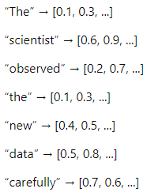
LLM Architecture - How it Works?
1
Input Embedding
“The scientist observed the new data carefully.”
Transform the Sentence into Vectors - Each word in the sentence is converted into a dense vector representation.

Slide 13
LLM Architecture - How it Works?
2
Self-Attention Mechanism
Calculate Attention Scores - Determine how much focus each word should have on other words in the sentence.
Each token is then converted into a numerical representation (an index in the model's vocabulary).

Slide 14
LLM Architecture - How it Works?
2
Self-Attention Mechanism
The word “scientist” might have its representation updated to emphasize its connection to “observed” and “data.”
Generate Contextual Representations

Slide 15
LLM Architecture - How it Works?
3
Feed-Forward Neural Networks
Refine Representations - After self-attention, the model processes the updated representations through a feed-forward network to enhance their features.
The representation of “scientist” now more accurately reflects its role in the sentence, related to “observed” and “data.”

Slide 16
LLM Architecture - How it Works?
4
Positional Encoding
Add Positional Information - Incorporates information about each word’s position in the sentence to maintain the order and structure
Ensures that the word “carefully” is understood as an adverb modifying “observed” rather than being interpreted in isolation.

Slide 17
LLM Architecture - How it Works?
5
Output
Generate Text or Predictions - The processed information can be used to perform various tasks such as text completion, summarization, or answering questions.
If the task is to predict the next word or sentence, the model might generate: “The scientist observed the new data carefully and concluded that...” based on the context provided.

Slide 18
Types of LLM

Slide 19
Types of LLM
Encoder-
decoder Models
Pre-trained & Fine-tuned Models
1
2
3
4
5
Autoregressive Language Models
Transformer-Based Models
Multilingual Models

Slide 20
Applications of LLM

Slide 21
Applications of LLM
01
NLP
02
Conversational Agents
03
Content Creation
Generation
Summarization
Sentiment Analysis
Customer Service
Virtual Assistants
Copywriting
Script Writing
Story Writing
04
Education and Training
05
Healthcare
Personalized Learning
Language Learning
Diagnostic Assistance
Medical Record Summarization

Slide 22
Hands-On: LLM Implementation using Pre-trained Transformers

